Slide 1

EASTERN European startup entry into silicon valley … swimming with the big fish
VAL JERDES, partner
INNOV8 GLOBAL VENTURES|ADVISORY|LABS
iForum – Kiev – 20 April 2016
INFO
@I8ga.com

Slide 2

Update from silicon valley … has the bubble burst yet?

Slide 3


Definitely not … the pond (and fish) have gotten even bigger

Slide 4

Culture beats strategy

Slide 5


Slide 6


Slide 7


Slide 8
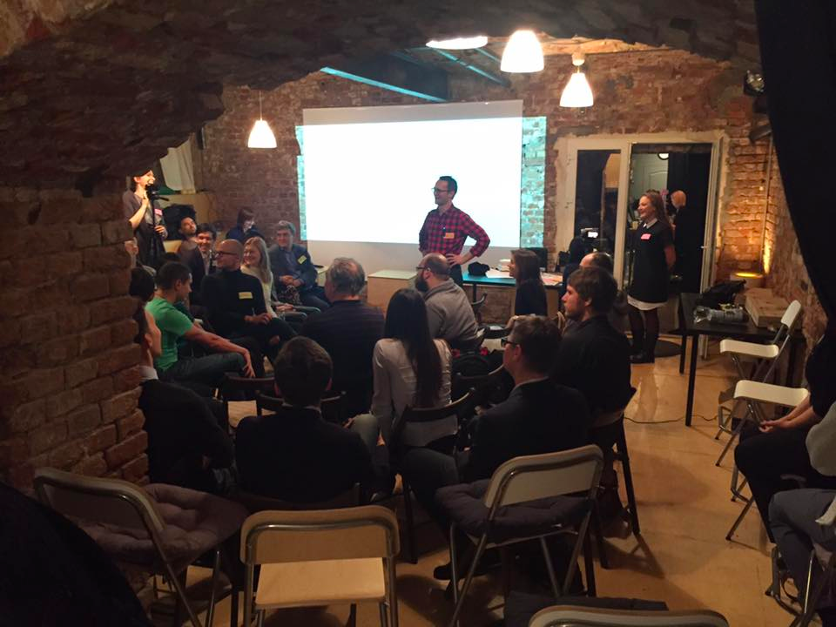
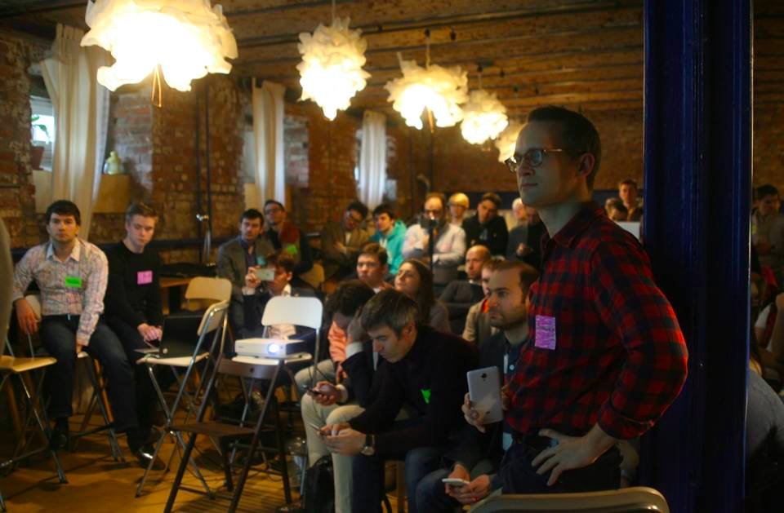
A project of Innov8 Global Labs
www.yellowdoor.ru
Страстной бульвар, д.12/1
(вход со двора, Желтая Дверь)
Moscow
… also main office in Silicon Valley, Berlin, New York, Beijing, presence in Kiev through Growthup

Slide 9


Slide 10

Venture Capital
Legal
Management
Intellectual Property
Strategic

Slide 11
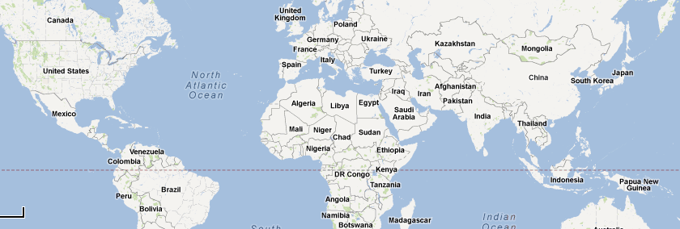
Expertise, Capital, Partners
Customers
Customers
Customers
Customers
Customers
Capital,
Technology
Advisor
Marketing
Partner
Expertise
Manufacturing

Slide 12
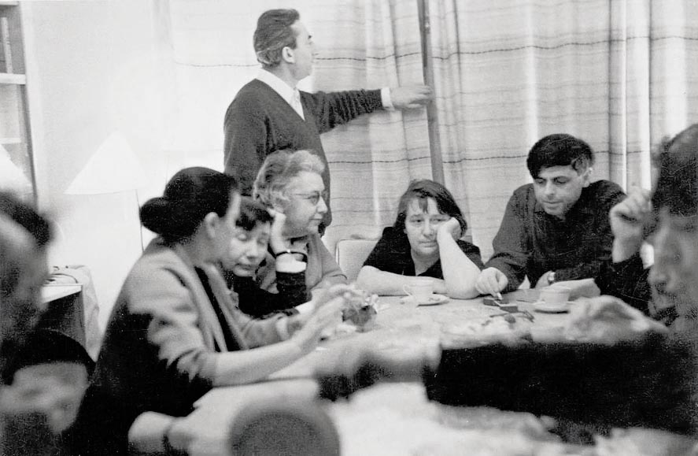

Slide 13


Slide 14
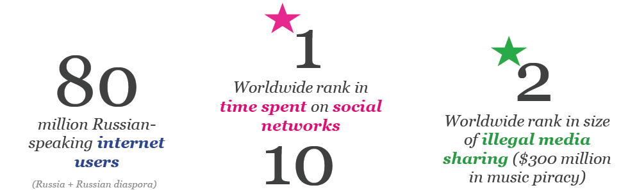
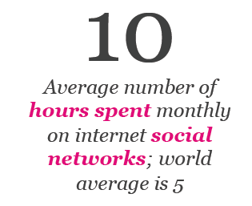

Slide 15

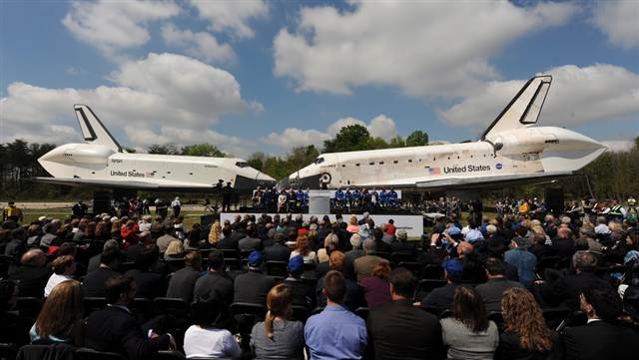


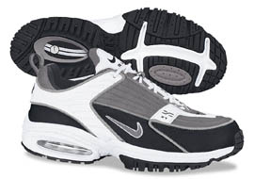
?
30,000 spin-offs
$2.5 trillion

Slide 16

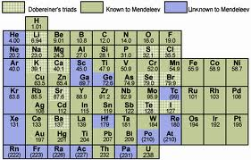
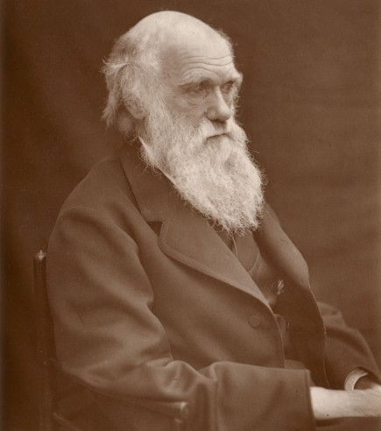
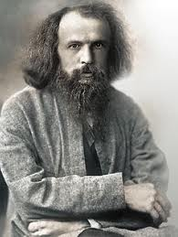

Slide 17

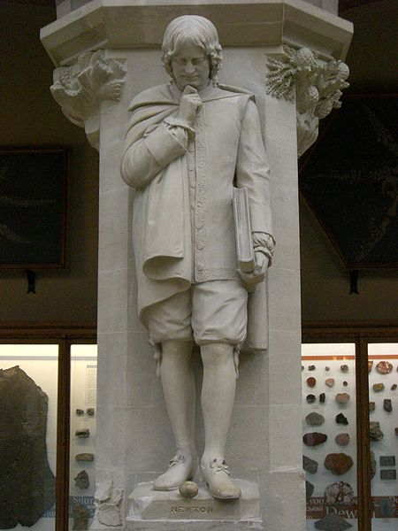

Slide 18


Slide 19


Slide 20


Slide 22
Hardware
Software
People
Professional
Physical
Policy
Diversity
Motivation
Social Trust
Rule (breaking)

Slide 23

Hardware
Software
People
Professional
Physical
Policy
Diversity
Motivation
Social Trust
Rule (breaking)

Slide 24
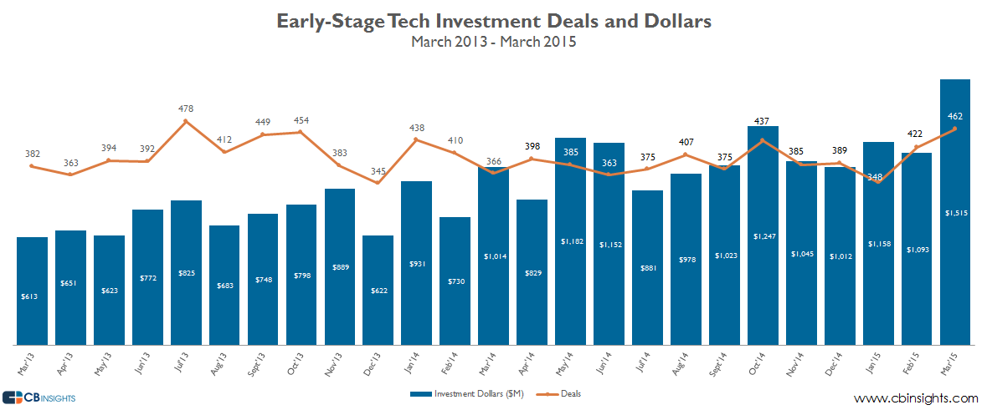
EARLY STAGE TECH INESTMENT DEALS & DOLLARS
Notes:
March saw over $1.5B, a multi-year high, going to early-stage startups across over 462 deals. We’ll look at early stage (angel – Series A) technology financings and some of the hottest early-stage tech companies based off of social media, news, and web traffic momentum that were funded in March 2015.

Slide 25
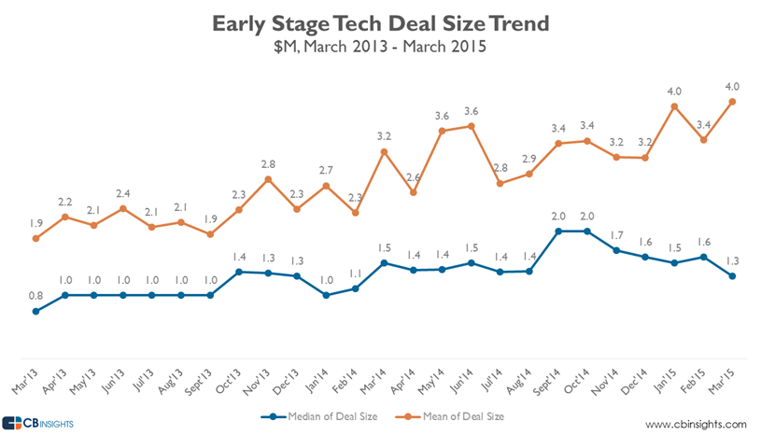
Early stage tech deal size trend
Notes:
OVERALL MEDIAN DEAL SIZES FALL BELOW $1.5M
The median round size across all early-stage Tech deals fell to its lowest figure since February 2014, at $1.3M. Median early-stage deal sizes have now fallen in 4 of the last 5 months. Averages tick up as a handful of large early stage deals serve to bring up the averages.

Slide 26
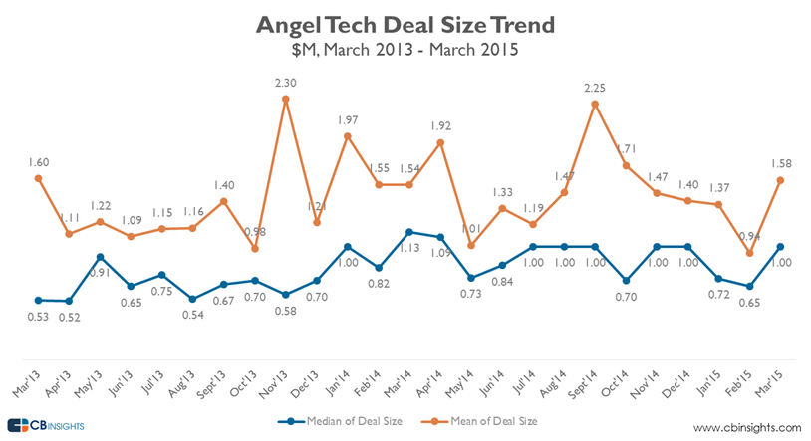
Angel tech deal size trend
Notes:
ANGEL ROUND SIZES POP IN MARCH
After mean and median deal sizes fell in February, Angel rounds jumped to $1.58M on average, and $1M on a median basis. Median angel round sizes have now reached $1M+ in 7 of the last 12 months.

Slide 27
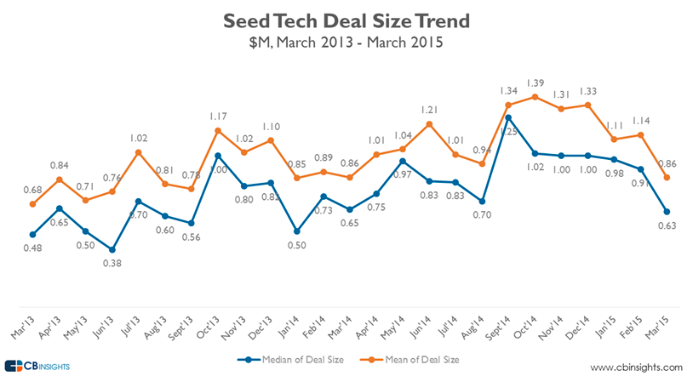
Seed tech deal size trend
Notes:
SEED DEAL SIZES FALL OFF CLIFF IN MARCH
Median Seed deal sizes in Tech fell 30% to $0.63M in March, their lowest number since January 2014. Mean Seed deal size also fell drastically to $0.86M, matching March 2014’s round size. Seed deal sizes have been trending down over the last many months. While the large Seed deals do get a lot of attention, they remain the exception.

Slide 28
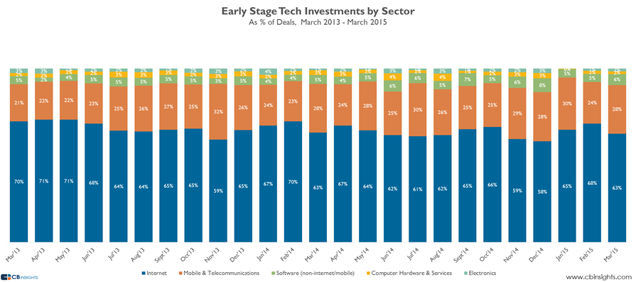
Early stage tech investments by sector (% of deals)
Notes:
MOBILE BOUNCES BACK, INTERNET FALLS
Mobile startups bounced back from just 24% of all early-stage Tech deals in February, to 28% in March. Internet deals fell from their 12-month high of 68% to 63% in march.

Slide 29
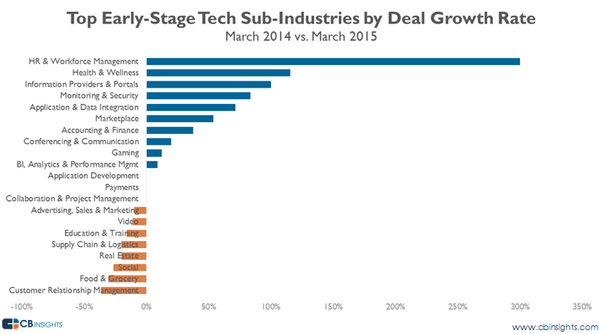
Top early-stage tech sub-industries by deal growth size
Notes:
MOMENTUM
HR & WORKFORCE MANAGEMENT TOPS GROWTH
HR & Workforce Management startups saw the largest deal growth of any tech sub-industry in March 2015 vs. the same month a year prior, with over 15 deals done last month. CRM startups saw the largest decline, but the sub-industry still had over 10 deals in March 2015.

Slide 30
Most active vcs
Overall
New Enterprise Associates
Andreessen Horowitz
First Round Capital
Slow Ventures
Sequoia Capital
Accel Partners
Foundry Group
Kleiner Perkins Caufield & Byers
Khosla Ventures
Atlas Venture
CRV
True Ventures
Qualcomm Ventures
RRE Ventures
Formation 8 Partners
Early Stage
East Ventures
500 Startups
Andreessen Horowitz
BoxGroup
New Enterprise Associates
Index Ventures
Lerer Hippeau Ventures
First Round Capital
Monk’s Hill Ventures
IDG Ventures
RRE Ventures
Notes:
EAST VENTURES TOPS MOST ACTIVE VCS
East Ventures was the most active early-stage Tech VC in March. The Indonesia-based VC invested in a slew of Seed deals including Shopback, Oddle, and Polyglots, among others. 500 Startups was second with multiple Seed and Series A investments including Visual.ly and Zipmatch.
As the venture capital space continues to mature, we’re witnessing a similar pattern. Elite, top-tier firms have a sustainable competitive advantage with both entrepreneurs and LPs alike, given their brands, their vast networks, and their self-reinforcing success. They also don’t focus their strategies on any particular location, sector, or stage. Instead, they find themselves in a diverse set of broad-market competitors doing whatever it takes to identify and catch the next unicorn. Just to cite two examples from the past year, NEA recently raised a $2.6 billion fund and Andreessen Horowitz raised $1.5 billion.
----------------
VC-Backed exits slowed in Q1’15, with a total of 138 exits (down 19% from the previous quarter). There were only 12 VC-backed IPOs in Q1’15 compared with 24 a quarter prior. Box was the only billion dollar VC-backed tech IPO in the US this past quarter. But new private unicorns kept coming with 7 private tech companies joining the unicorn club.
Massachusetts Overtakes New York In VC Deals And Dollars
Massachusetts beat out rival tech hub New York in number of VC financings in Q1’15, with $1.37B invested across 93 deals. Mass. saw an increase in the number of deals in healthcare and mobile companies, which helped push it past the Empire State. For a full list of investment activity by state, download the full report.
Venture Capital financing slowed down in Q’15, with VCs investing $11.3B across 805 deals. This is the first time since 2011 that deal activity has dropped below the 900 deal mark, while funding in VC-backed companies has hit a high breaking $17B of investment.
This in-depth report analyzes financing and exit trends across U.S.-based rounds in which VCs participated as well as top investors, exits and deals in Q1'15. Below is a high-level summary of some of the report’s highlights. For all of the findings, download the entire report. It’s free.
2015: $11.3B Invested In 805 deals, VCs Are Getting Crowded Out
When investments from hedge funds, mutual funds and private equity investors into VC-backed companies are included, VC-backed companies actually raised $17.7B of funding in Q1.
Late-stage VCs are (1) facing more competition (2) don’t have the assets under management of these other players and (3) may also not be willing to offer valuations of these newer players.
Healthcare Deals Moving Away from Major Tech Hubs
For the first time since 2013, California and Mass took less than 50% of healthcare deals. States outside of the major tech centers took nearly 44% of healthcare deals, with the most deals happening in Missouri, North Carolina, Pennsylvania, and Tennessee.
Lots of Unicorn Financings; Not Many Unicorn Exits
VC deals in Q1'15 hit a nine-quarter low and fell for the fourth straight quarter. Though VC funding decreased 18% vs Q4’14, this doesn’t tell the whole story.
New Enterprise Associates: Q1’15’s most active VC firm
In the midst of raising one of the largest funds in history, NEA also topped the list of most active investors of Q1’15 followed by Andreessen Horowitz and early-stage VC First Round Capital.
A list of the 15 most active venture capital investors by unique company deals is below.

Slide 31


Notes:
But during that same decade, the microbrewery phenomenon emerged, and it continues to boom today. All of these breweries compete with a segmentation strategy, focusing in a specific region and/or concentrating on a specific style or type of beer. A Stone Brewery IPA doesn’t taste like an Ommegang Witte or the Belgian-style ale found only in your local brewpub. And all of these taste very different than a Bud Light.
Yet despite that bifurcation, the two segments not only coexist, they thrive.

Slide 32
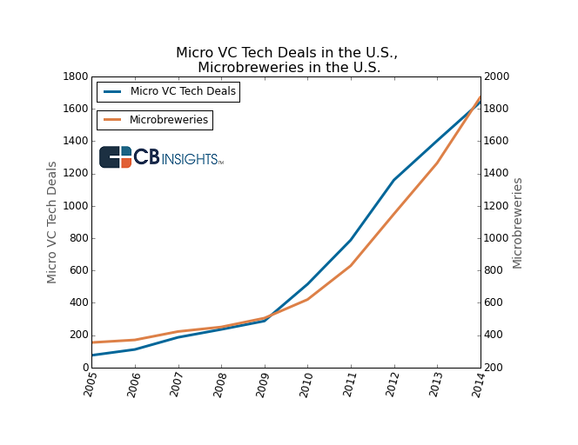
MICRO Vcs and micro breweries (us)
Notes:
After issuing the correlation, David Beisel (@davidbeisel), a partner at NextView Ventures, reached out with a thoughtful guest post on the rise of the craft brewer VC firm. In it, he writes that "if you want to win in a maturing industry, you need to be either Budweiser or a laser-focused craft brewer."
You should go read it especially if you're interested in why the micro-VC phenomena continues to gain steam.

Slide 33

Almost half of the VC funds raised in the last 6 months were Micro- VCs (those with < $50M AUM)
Notes:
The Micro VC Glut –
Ultimately, all of this is a great thing for entrepreneurs. Just like beer drinkers, top entrepreneurs now have an increasing amount of choice. More VCs mean more sources of capital, especially at the seed stage. And with the increased competition, more and more firms are turning to founder-focused initiatives like platform and other in-house services to compete. These are only positives for the entrepreneur.
Whether you’re running a venture firm or a brewery, the most profitable approaches are to go big & broad or narrow & specialized. As the VC market continues to mature, the results of these strategies will become much clearer.

Slide 34
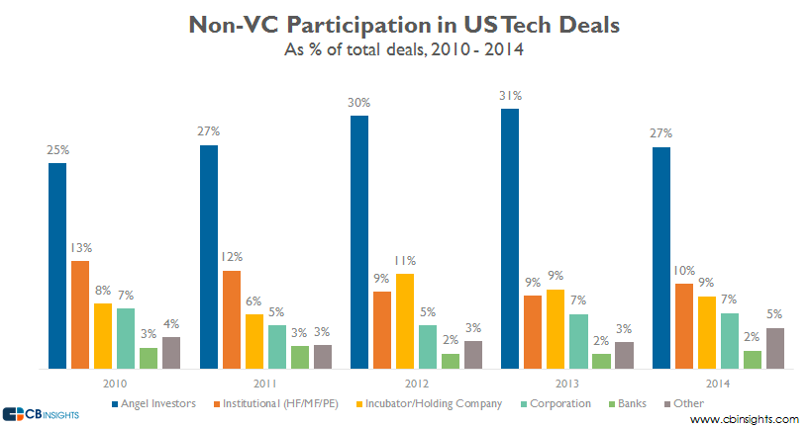
Non-vc participation in us tech deals
Notes:
When it comes to non-VC investors, angels participate in the most US tech deals, while other, less traditional investors reached their highest participation rate in the past 5 years in 2014. VCs accounted for only 49% of all US Tech deals, but what’s going on with the non-VCs?
The chart shows that angel investors (both individuals and angel groups) participate in the highest % of US tech deals of all non-VCs, at 27% in 2014, down 4% from 2013, and the lowest figure since 2011. The decrease could possibly be due to the rise of micro-VCs and these funds crowding angels out of very early-stage deals.
We recently have seen increased activity for a select group of hedge and mutual funds investing in tech, however overall institutional investor participation is actually down versus 2010 and 2011. Alternatively, corporations have stepped up their activity over the past two years, participating in 7% of all US Tech deals in 2013 and 2014. Other less traditional investors which include universities, endowments, governments, and more, increased to 5% of all US tech deals in 2014, a five-year high.

Slide 35
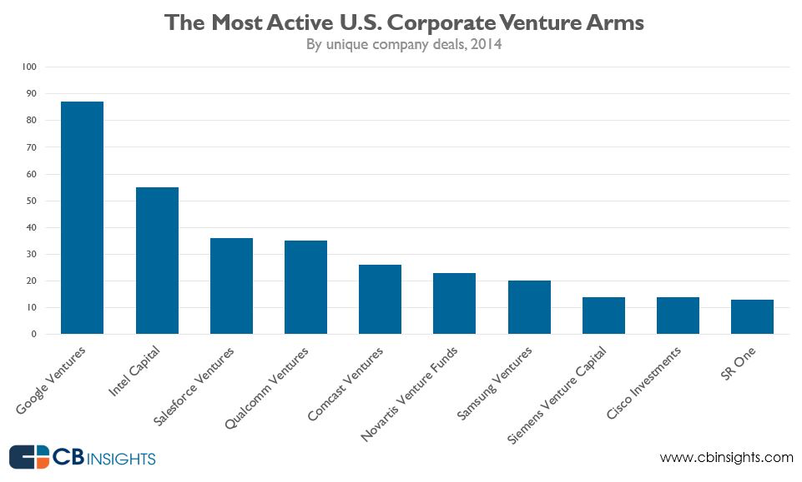
Most active us corporate venture arms
Notes:
Last July, Twitter exec Mike Gupta stepped down from the CFO perch to oversee a new initiative to invest in start-up companies on behalf of the company. Recently, Twitter’s venture group, Twitter Ventures, has unveiled its first investment in Cyanogen, the Android community OS.
The debut of Twitter Ventures comes as corporate venture arms are playing an increasingly large role in the overall venture ecosystem. As their parent companies bulk up with big balance sheets, corporate venture arms participated in just under 1/5th of all 2014 venture deals in the U.S.
But does cash correspond with more corporate venture deals? Apparently not, according to CB Insights data.

Slide 36
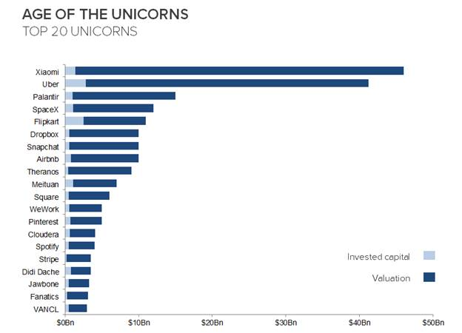
Introduction
Notes:
The last economic “aberration,” 15 years ago now, was such a spectacular collapse that industry pundits today are still left with remnant aftertaste of the dotcom nuclear winter. So naturally, many of the same pundits are now quick to draw comparisons between then and now.
And why shouldn’t they?
In 2014 alone, venture capitalists plowed over $48 billion dollars into more than 4,350 startups; the strongest investment activity since the pre-2000s. There are a record number of startup “unicorns” – VC-backed companies valued at over $1Bn – in existence, including well-known names such as Uber, AirBnb, and Dropbox. Altogether, as of this writing, there are now 78 unicorns, and more than 20 of them reached this milestone in just the past year.

Slide 37
Will trade home for stock options

Slide 38
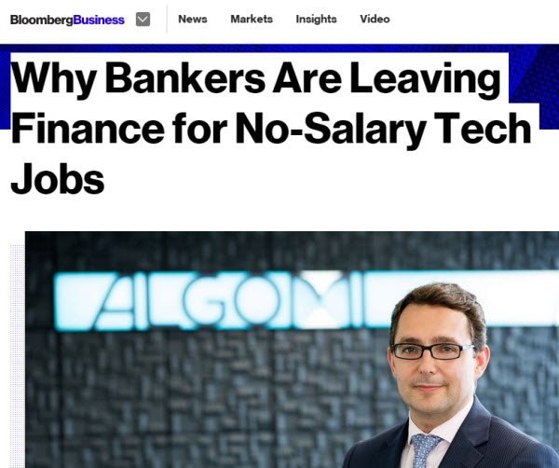
The bankers are coming

Slide 39
Notes:
Perhaps the biggest holistic difference between then and now is that in 2000, companies were attempting to change what people do with novel but poorly executed alternatives, whereas today, the tech industry is successfully changing how people do things due to the confluence of major technological developments. Today, technology is no longer a separate industry but rather an underlying utility: from the way consumers access information to how business decisions are made, tech is irreversibly changing both consumer behavior and enterprise workflow. Even areas traditionally considered high-touch and low-tech – hospitality and transport for example – have been transformed (e.g. AirBnb and Uber).
So for the reasons above, we assert that we are in a boom, and not a bubble. The transformative impacts of innovation, such as the empowerment of mobile technology, the maturation of digital media, and the proliferation of data and analytics are changes that are here to stay. But will there be a readjustment? Yes – the tech market is extremely active, interest rates are near zero, and investors are sitting on stockpiles of cash, so yes, there is the potential (and we believe likelihood) for a correction in valuation. Some unicorns may die, VC rounds may swing back to less heated valuations, but the current surge in innovation will not collapse in on itself – this time around, the changes are fundamental and the progress irreversible.

Slide 40
“It’s not a tech bubble. It’s the biggest wave of innovation in the history of the world.”
- Marc Benioff, Salesforce.com
Notes:
Perhaps the biggest holistic difference between then and now is that in 2000, companies were attempting to change what people do with novel but poorly executed alternatives, whereas today, the tech industry is successfully changing how people do things due to the confluence of major technological developments. Today, technology is no longer a separate industry but rather an underlying utility: from the way consumers access information to how business decisions are made, tech is irreversibly changing both consumer behavior and enterprise workflow. Even areas traditionally considered high-touch and low-tech – hospitality and transport for example – have been transformed (e.g. AirBnb and Uber).
So for the reasons above, we assert that we are in a boom, and not a bubble. The transformative impacts of innovation, such as the empowerment of mobile technology, the maturation of digital media, and the proliferation of data and analytics are changes that are here to stay. But will there be a readjustment? Yes – the tech market is extremely active, interest rates are near zero, and investors are sitting on stockpiles of cash, so yes, there is the potential (and we believe likelihood) for a correction in valuation. Some unicorns may die, VC rounds may swing back to less heated valuations, but the current surge in innovation will not collapse in on itself – this time around, the changes are fundamental and the progress irreversible.

Slide 41


Slide 42
Silicon valley funding ecosystem is just getting better
www.i8ga.com

Slide 44

Look! A Unicorn!

Slide 45

But In Reality… (and apologies in Advance)
Nobody Cares
* So what do they care about?

Slide 46

This isn’t HBO … it is Extremely difficult

Slide 48
What percent get funded? Very, very few

Slide 50


Slide 51

Stand on the shoulders of giants

Slide 52
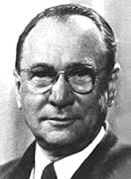
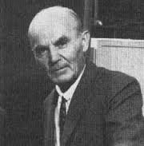
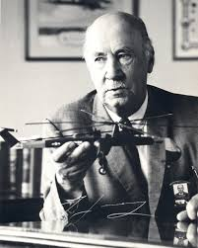
Waves of immigrants - revolution
Vladimir Zworkyn
Television pioneer
Alexander M. Poniatoff,
audio pioneer - Ampex
Igor Sikorsky
Aviation pioneer

Slide 53

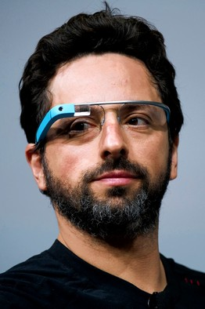

Wave of the 1970s
Phil Libin
Vlad Schmunis
Sergei Brin
Max Levchin
Stepan Pachikov

Slide 54

Current wave … massive!
Ivan Tsybaev
Max Skibinsky
Andrey Filev

Slide 55


Slide 56
Some paths
As an Employee
Get a large US company to sponsor your visa and move you
Build your startup in parallal, network with the local community of entrepreneurs and investors
After 2-4 years, you’re ‘local’ and you can figure out your way into a new visa, startup, funding, etc
Takes time, but works well if you’re committed to the US
As an Foreign Entrepreneur
Raise seed at home, for a global product validated locally … target a global footprint
Raise a later Series in the US to expand/grow
Grow business development office abroad
Takes even more time … but possible
** Extra cool – go through an accelerator
Just show up …
… get a plane ticket, figure out some angle, eventually move your family
The fourth path…

Slide 57

… as an employee
Ilya Semin, Datanyze
Built startup literally in his basement, while working for a Silicon Valley company as an engineer.
Raised $2M seed investment from Google Ventures, Mark Cuban and IDG Ventures … the only round he’ll need to raise
25% M-O-M growth
Profitable after reaching$ 1M ARR
“People are generally always willing to help, especially when you're not asking for money. Ask for feedback first, and that's what propelled mybusiness to early success.
The biggest lesson I learned was: If you want advice, ask for money. But if you want money, ask for advice.”

Slide 58

… through an incubator/accelerator
PetCube, Wakie … now about 1-2 per class in Y-Combinator and 500 Startups
Winter 2016 YC class, raised $2.6 million
Kickstarter campaign blew past its $100,000 goal to raise over $250,000
Almaz Capital, Y Combinator, and AVentures Capital, and brings Petcube’s total funding to $3.8 million to date
hire local biz dev (at no small salaries) = Significant burn rate
B-2-C … extremely tough for non-natives
hardware element (manufacturing, distribution, etc) ...
Massive squeeze to margins

Slide 59

The fourth path …
A curated way …
for entrepreneurs, as well as foreign Venture Funds, Corporates, Ecosystem Builders
Requirements:
Plan ahead, ask for help
Spend lots of time on planes
Create a presence in US
Generate momentum
Make silicon Valley a part of your Routine
Get Customer Traction
in US
… THEN raise money
… this happens
IN PARALLEL!

Slide 60

There is no such thing as ‘fundraising mode’ …. You are always fundraising
Build a Business
Create Momentum
Product/Market Fit
(do your customers want what you are selling?)
+
Distribution
(can you effectively get your product to your customers?)
+
Business Model
(are you able to
make money?)
Users
Customers
Partners
Advisors
New Hires
Investment Commitment
Thought Leadership
Press

Slide 61



Silicon Valley = reinforcing ecosystem
Early Adopters and Customers
Knowledge & Innovation
Multi-stage Capital

Slide 62
Creating Momentum
Set-up
Visit
Follow-Up
Planning Ahead
What To Do
Ensuring Continuation
Repeat …

Slide 63
“I Know I Need to Come, But…” Create momentum remotely
“…I need to first do a pilot at home, so I have something to sell and not ‘burn’ myself”
“… coming every few months is enough”
“… I will hire a US Sales person to do the work”
“…I have the best tech, so they will buy from me”

Slide 64
The Set-Up
It’s Always Good Timing (advice/feedback, trial, sell)
Identify Customers, Partners, Sources of Feedback (relevant, motivated)
Plan ~6 Wks Ahead, Visit for at Least 4 Wks (Anchor, conference/meetups, 50-75% planned)
Ask for Help!

Slide 65
The Visit
Know Your Story (why they should care, what do you need)
Build Relationships, Emphasize Context (listen & learn, project continuity vs. quick hit)
Ask for & Schedule Follow-Up Meetings
Allow for Semi-Planned Networking (Meetups, “Stand in Luck’s Way”)
Meet *Some* Investors (friends)
Ask for Even More Help!

Slide 66
The Follow-Up
Track & Summarize
Send Personalized Messages (recap, give back)
Ensure Momentum (action items, updates)
Plan Your Next Trip (In person > Skype)

Slide 67
Why?
“Between the execution risk (that is within your control) and the risk of not being in Silicon Valley (which becomes out of your control), I choose the former. I want to choose the risk I take.”
-- Noam Bardin, Waze CEO

Slide 68
10 Best Practices
How
CEO/Founder in US, Co-founder in local market
Product/Engineering Alignment
Constant flying
When
STSSTIAP → Early Product
Don’t Wait for Funding
Don’t Wait to complete Pilot in local market
Get out of the building
Hire US employees
Prioritize PR (when ready)
What
10. DO YOUR RESEARCH!!

Slide 69
Investor Goal: Big-Ass Returns

Slide 70
Common Pitfalls: The Short List
Not Being Positive and Upbeat
Giving the Impression You Know Everything
Trying to raise too early / too late
Transactional vs. Relationship-Oriented
Not Knowing Your Story or What You Want
Not Knowing Person, Company, Competition
Badmouthing/Dismissing the Competition
‘This is a huge market’ slide … build bottom-up
The Exit Slide on the deck (we’ll show you the exit door)
Pilot In at home

Slide 71
Amidst all the noise, what should entrepreneurs do?
Forget VCs – focus on customers
Get to powerful product – execution is key
If you get good customer traction, VCs will find you (usually when you don’t need them)
Capture maximal efficiency from local market – proof of concept, development
Keep global outlook, know the players and landscape, do your homework
Build a powerful board of advisors (usually can be done for free / almost free)
Leverage accelerator programs
Get to Silicon Valley … start with customers and channel partners
Raise syndicates, use all the levers (angel list, institutional VCs, corporate “strategic” VCs) … don’t valuate high, give away minimum, keep it honest
Err on the side of sharing rather than protection (IP, etc)
Move as fast as you can … the world won’t wait

Slide 72
Val Jerdes
Partner
Innov8 Global Ventures | Advisory | Labs
Cupertino, California
info@i8ga.com

